Slide 1


Deep Learning
Introduction
Hans
30/09/2021
Vision and Machine Learning Group Computer Science

Slide 2

Artificial Intelligence
Artificial Intelligence
AI is a machine that can think or act like our humans.
Machine Learning
Machine Learning is a subset of AI.
Deep Learning
Deep Learning is a subset of ML.
Vision and Machine Learning Group Computer Science
Notes:
AI: target
ML and DL: tool set

Slide 3
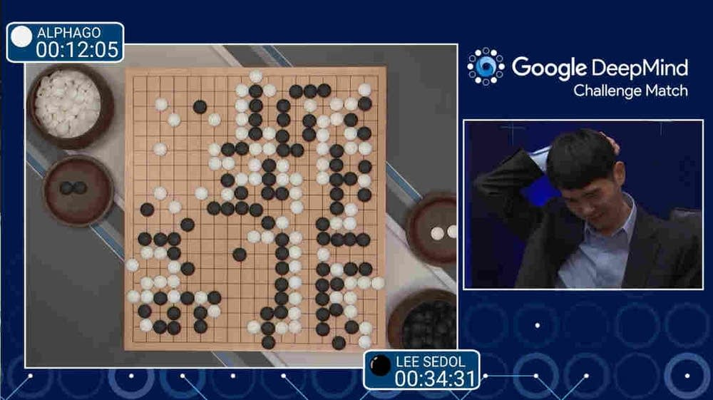

What is AI?
The theory and development of computer systems that are able to perform task normanlly requiring human intelligence such as visual perception, speech recognition, decision-making and translation between languages.
AI includes following areas of specialisation
• Gaming • Robotics • Automobiles
• Marketing • Social Media
......
Vision and Machine Learning Group Computer Science

Slide 4

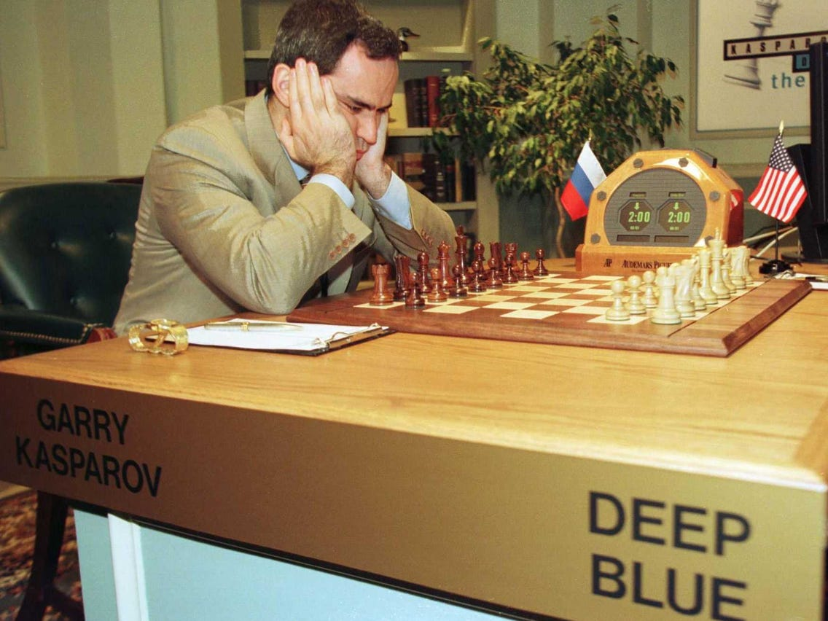
Typical AI Cases
Siri 2011
Atlas 2013
AlphaGo 2014
GPT-3 2020
Imagine 1990
<<Edward Scissorhands>>
Early 1997
IBM’s Deep Blue
Now 2011~
Massive Products
Vision and Machine Learning Group Computer Science

Slide 5
How to deal with problems?
HUMANS
COMPUTER
solve problems intuitively and automatically, like recognising spoken words or faces in images.
problems that can be described by a list of formal and mathematical rules.
AI
ML & DL are solutions to intuitive problems to allow computers to learn from experience and understand the world in terms of a hierarchy of concepts, with each concept defined in terms of its relation to simpler concepts.
Vision and Machine Learning Group Computer Science

Slide 6



How to realise AI?
1. Knowledge based methods: Hard-code knowledge about the world in formal languages and a computer can reason about statements in these formal languages automatically using logical inference rules.
It failed to understand a story about a person named Fred shaving in the morning.
This is a person!
Is this a person?
Vision and Machine Learning Group Computer Science

Slide 7

How to realise AI?
No Cramming!
Is there an AI system that has the ability to acquire its own knowledge?
Vision and Machine Learning Group Computer Science

Slide 8
How to realise AI?
2. Machine Learning:
Logistic Regression: can determine whether to recommend cesarean delivery.
Naive Bayes: can separate legitimate e-mail from spam e-mail.
SVM
Decision Tree
Ramdon Forest
......
how the features in the representations relate to the results.
REPRESENTATION
Vision and Machine Learning Group Computer Science

Slide 9
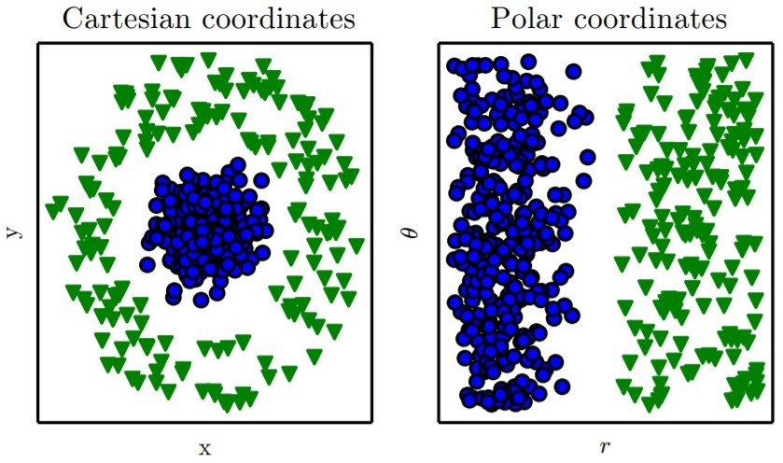
Representation
Suppose we want to separate two categories of data by drawing a line between them in a scatterplot. In the plot on the left, we represent some data using Cartesian coordinates, and the task is impossible. On the right, we represent the data with polar coordinates and the task becomes simple to solve with a vertical line.
Vision and Machine Learning Group Computer Science

Slide 10
Representation
Many artificial intelligence tasks can be solved by designing the right set of features to extract for that task, then providing these features to a simple machine learning algorithm.
Each piece of information included in the representation is known as a feature.
Manual extracting
Machine learning
SIFT
PCA, ICA, LDA
Haar
Decision Tree
Bag-of-Words
Representation Learning
N-Gram
Vision and Machine Learning Group Computer Science

Slide 11
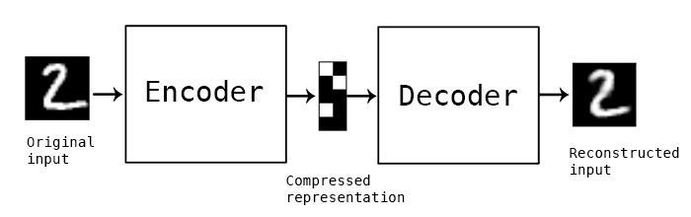
Representation Learning
Learned representations often result in much better performance than hand-designed representations, which allow AI systems to rapidly adapt to new tasks with minimal human intervention.
Autoencoder
Converts the input data into a different representation.
Converts the new representation back into the original format.
Vision and Machine Learning Group Computer Science

Slide 12
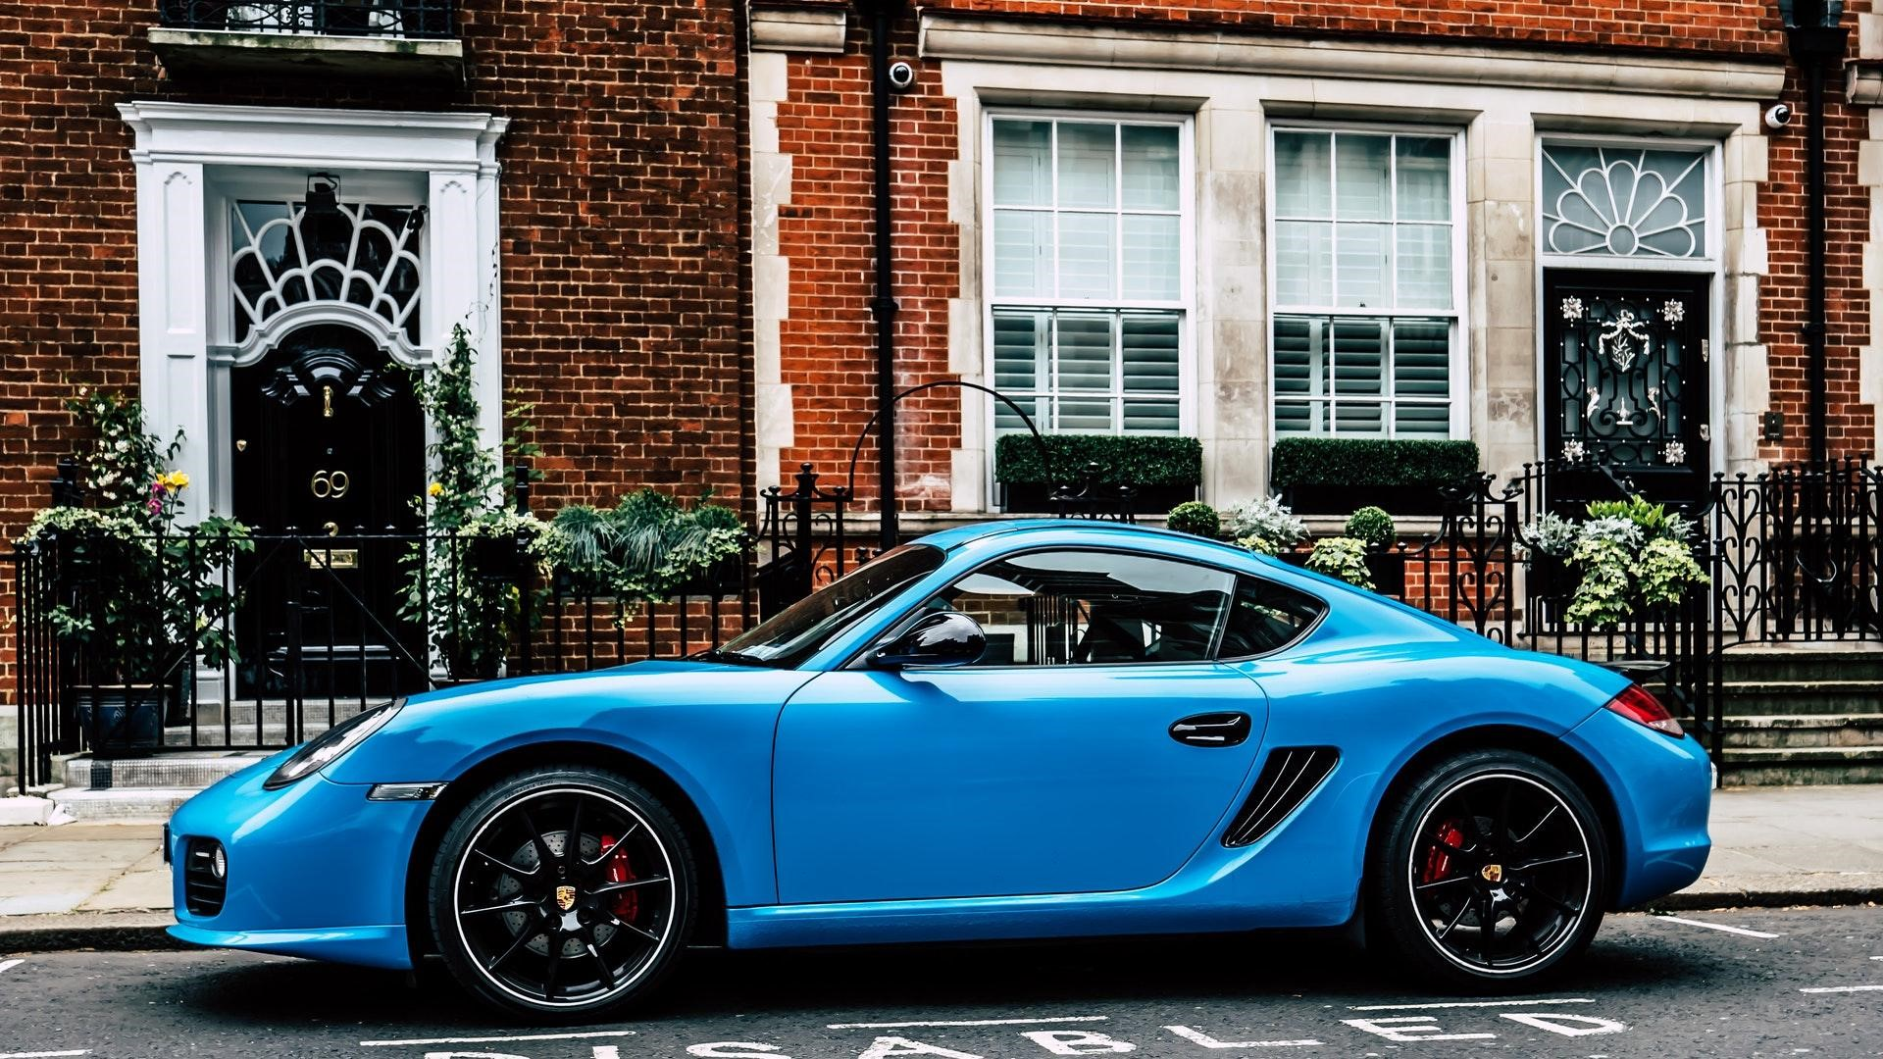
Factors of Variation
black door
white window
red brick wall
black handle
green plant
red light
black tyre
black wheel
gray road
white text
Label: Car
Vision and Machine Learning Group Computer Science

Slide 13
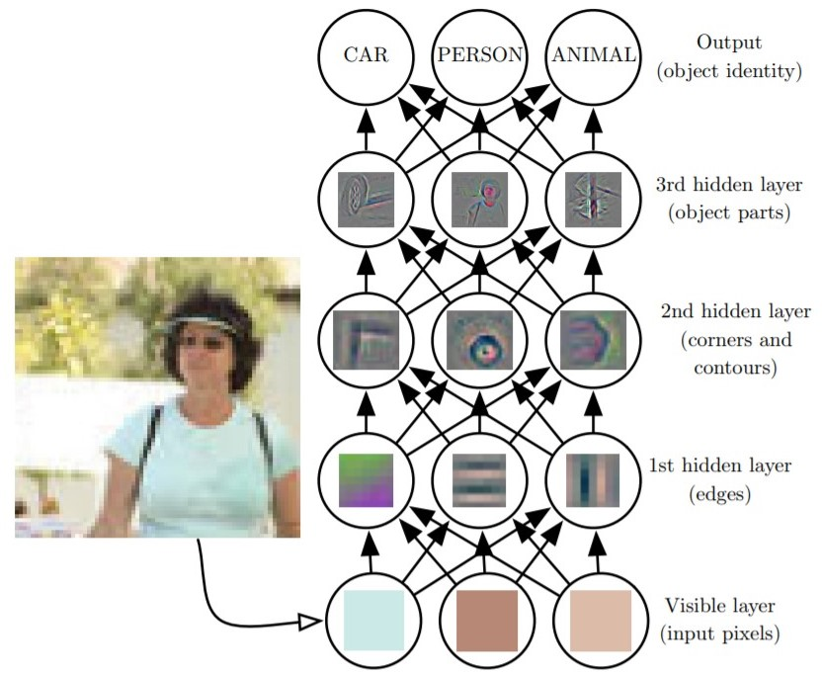
Deep Learning
In Representation Learning, how to identify the key factor of variation is difficult. While this issue can be addressed by Deep Learning, which allows the computer to build complex concepts out of simpler concepts.
MLP
CNN
RNN
Vision and Machine Learning Group Computer Science

Slide 14
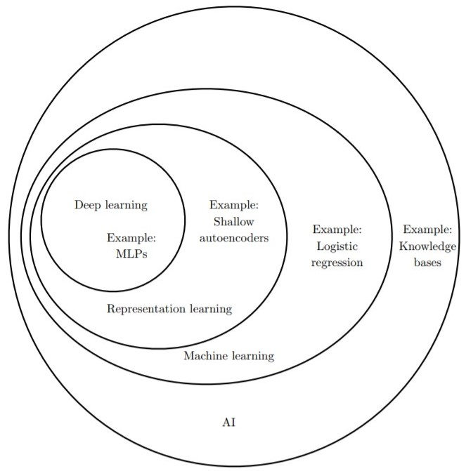
Deep Learning
Vision and Machine Learning Group Computer Science

Slide 15
Thank You
Vision and Machine Learning Group Computer Science

